Slide 1
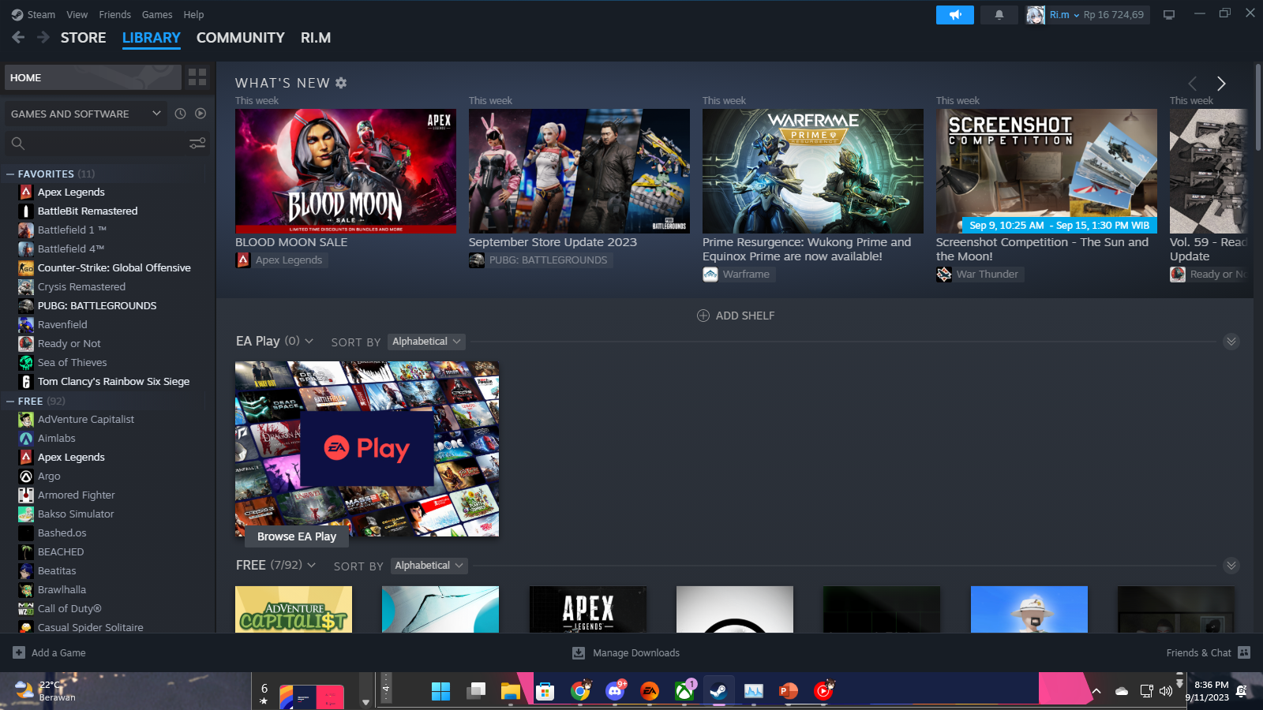

Dimas Adi Bayu Samudra | 2341720169
Vidi Joshubzky Saviola | 2341720112
INSTALLATON

Slide 2
Group Member
Dimas Adi Bayu Samudra | 2341720169
Vidi Joshubzky Saviola | 2341720112
INSTALLATON

Slide 3

LET’S STARTED
INSTALLATON

Slide 4
Firstly, Open your preferred web browser (e.g., Google Chrome, Mozilla Firefox) and go to the Steam download page: https://store.steampowered.com/about/
#STEP 1
Download Steam
Then, Click “INSTALL STEAM” button

Slide 5
Firstly, Open your preferred web browser (e.g., Google Chrome, Mozilla Firefox) and go to the Steam download page: https://store.steampowered.com/about/
Then, Click “INSTALL STEAM” button
#STEP 1
Download Steam

Slide 6
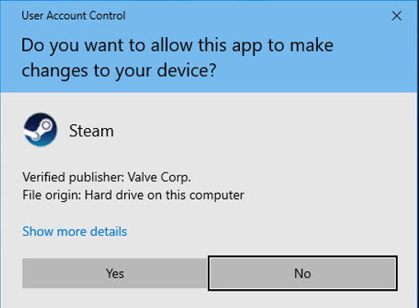
Firstly, Open your preferred web browser (e.g., Google Chrome, Mozilla Firefox) and go to the Steam download page: https://store.steampowered.com/about/
Once, the installer file is downloaded, locate it in your downloads folder or browser's download manager. It's usually named something like "SteamSetup.exe." Double-click on it to run the installer
#STEP 1
#STEP 2
Download Steam
Install Steam

Slide 7
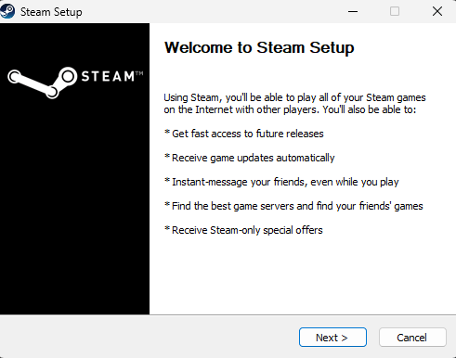
If you're using a Windows version that has User Account Control (UAC), you may see a UAC prompt asking for permission to make changes to your system. Click "Yes" to proceed.
#STEP 2
Install Steam

Slide 8
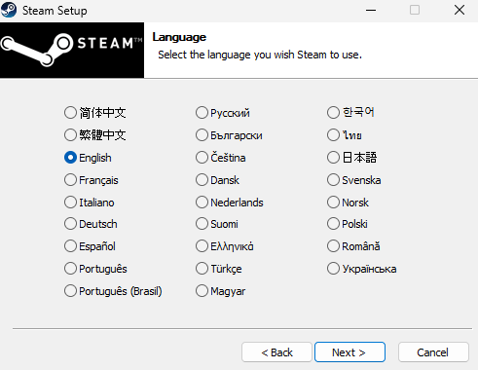
The Steam installer will open. Click "Next" to proceed with the installation.
#STEP 2
Install Steam

Slide 9
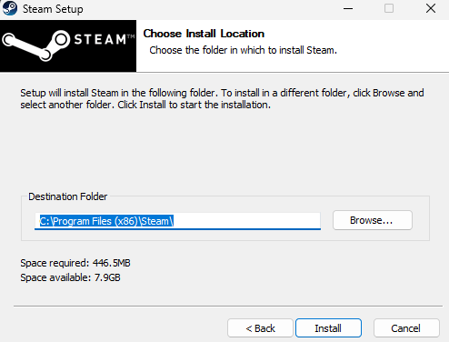
Then, Choose language for Steam
#STEP 2
Install Steam

Slide 10
Then, Choose the directory where you want to install Steam, or you can leave it at the default location. Click "Install" to continue.
#STEP 2
Install Steam

Slide 11
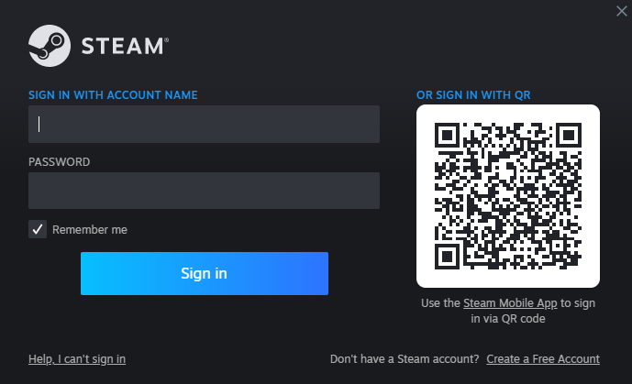
The installer will now download and install the Steam client. This may take a few moments.
#STEP 2
Install Steam

Slide 12
THANK
YOU
After the installation is complete, you'll be prompted to create a new Steam account or log in with an existing one. If you don't have an account, click "Create a new account..." and follow the on-screen instructions to create one
#STEP 3
#STEP 2
Final Step
Install Steam

Slide 13
THANK
YOU
Lastly, you'll have Steam installed and ready to use on your Windows computer. You can access your game library and explore the Steam community and store.
#STEP 3
Final Step

Slide 14
THANK
YOU
Lastly, you'll have Steam installed and ready to use on your Windows computer. You can access your game library and explore the Steam community and store.
#STEP 3
Final Step

